Slide 1

Employee Request Management–Process Flow
Home Screen
My Profile
My Approval
Create New Request

Slide 2
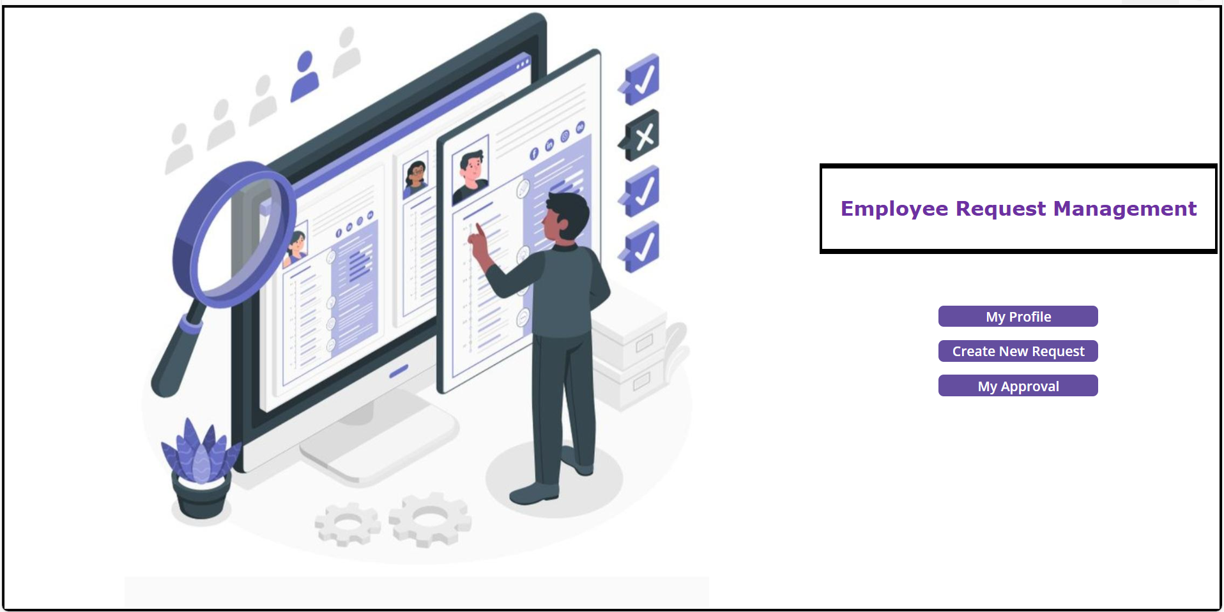
Home Screen

Slide 3
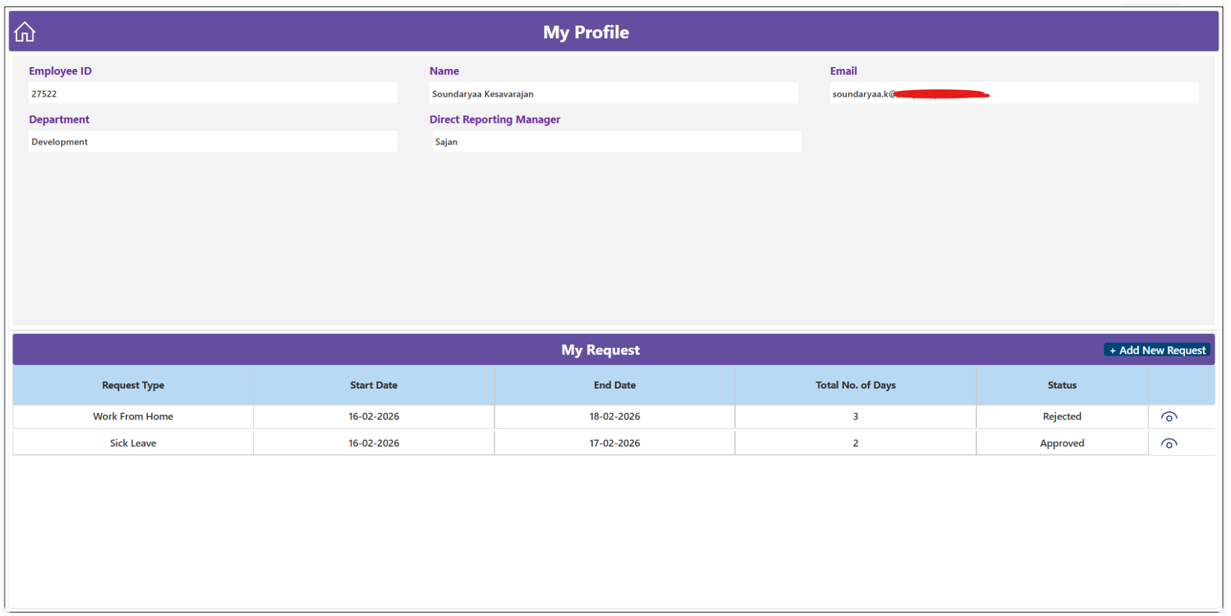
My Profile Screen

Slide 4
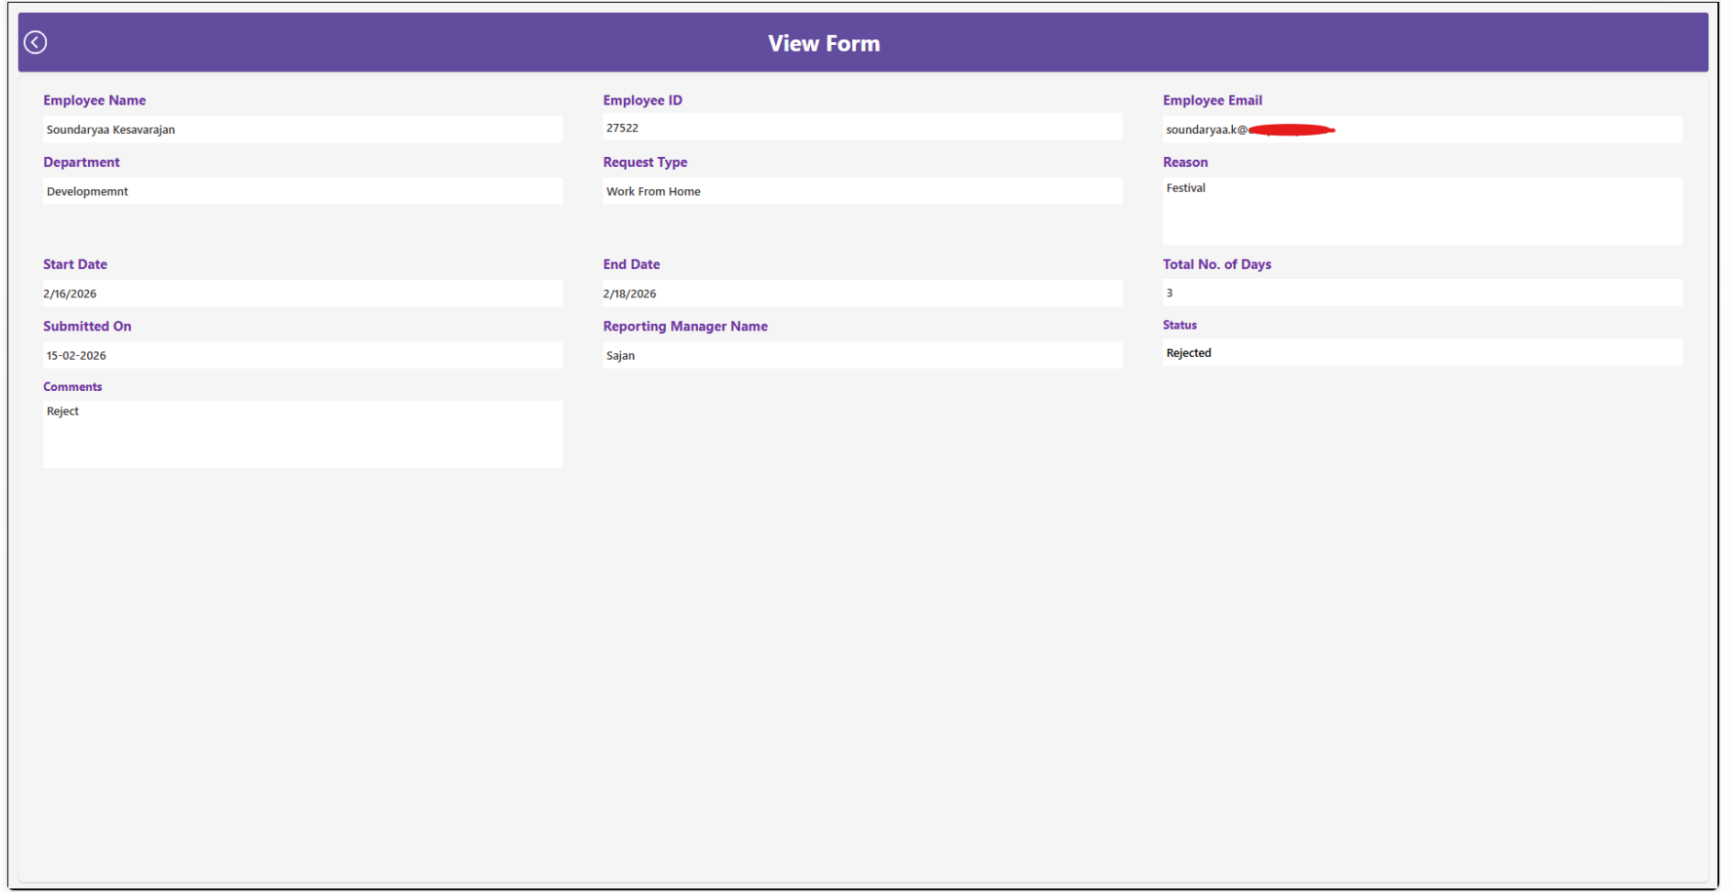
View Form Screen

Slide 5
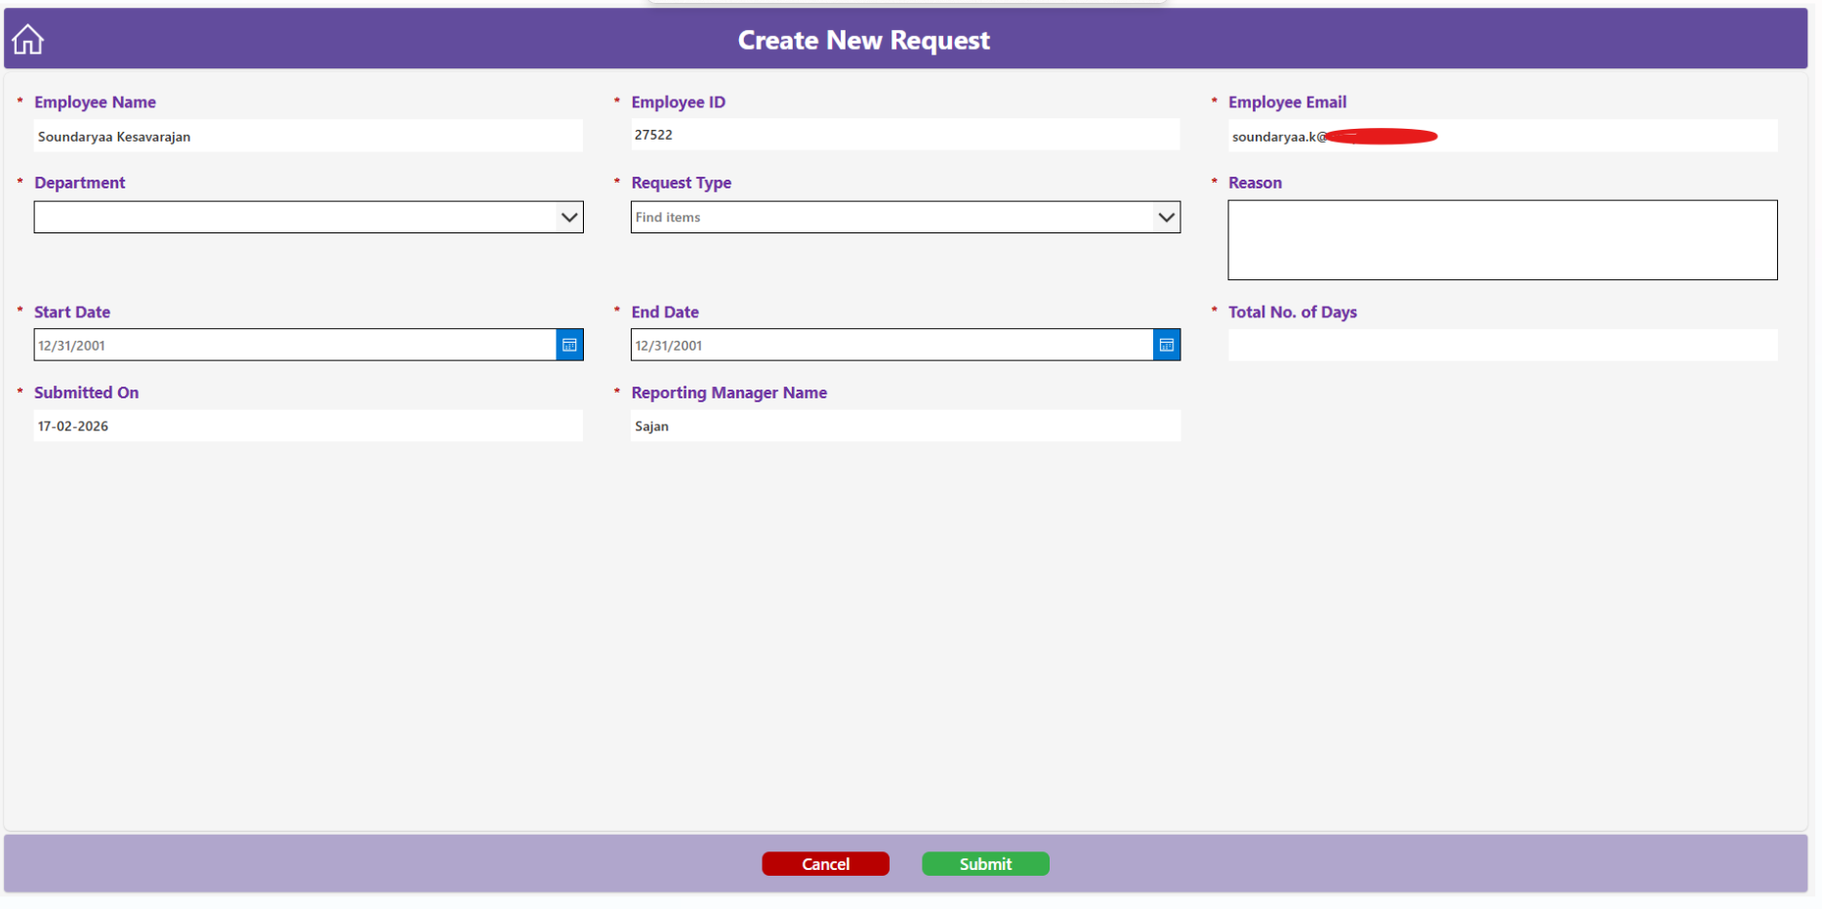
Create New Request Screen

Slide 6
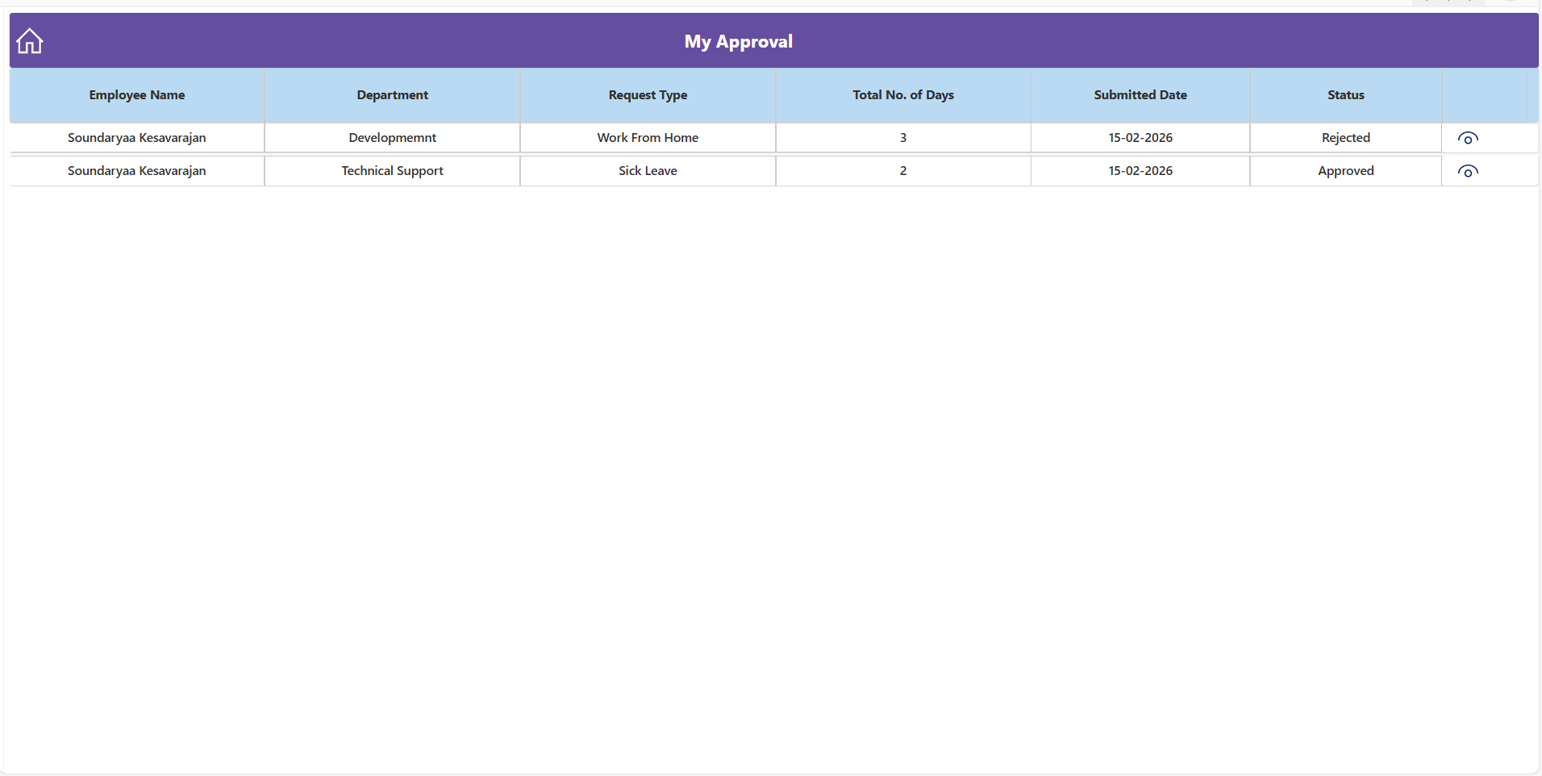
My Approval Screen

Slide 7
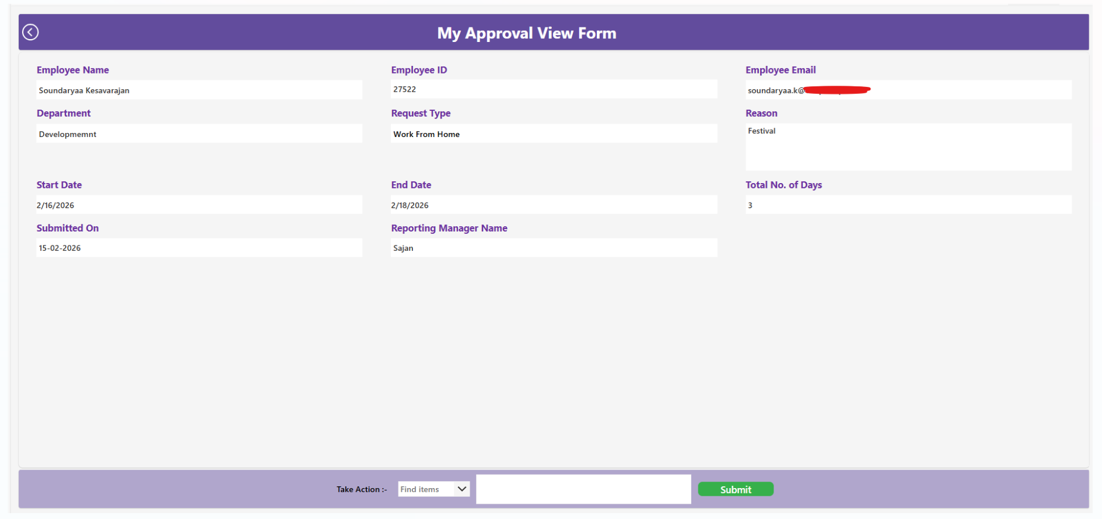
My Approval View Form Screen

Slide 8

SharePoint Lists

Slide 9
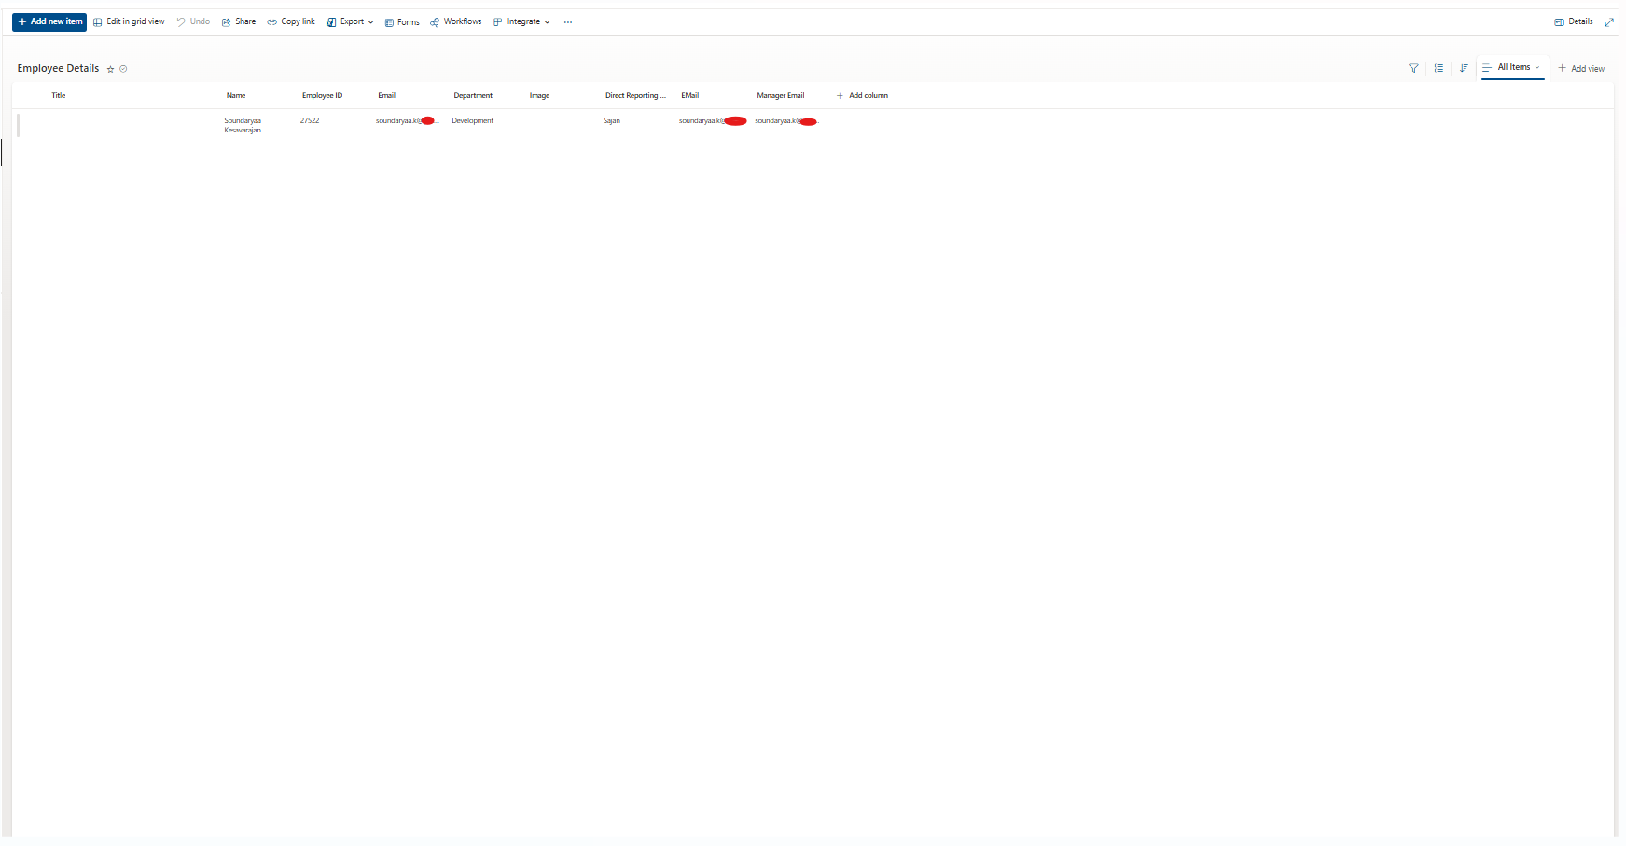
Employee Details SharePoint List

Slide 10
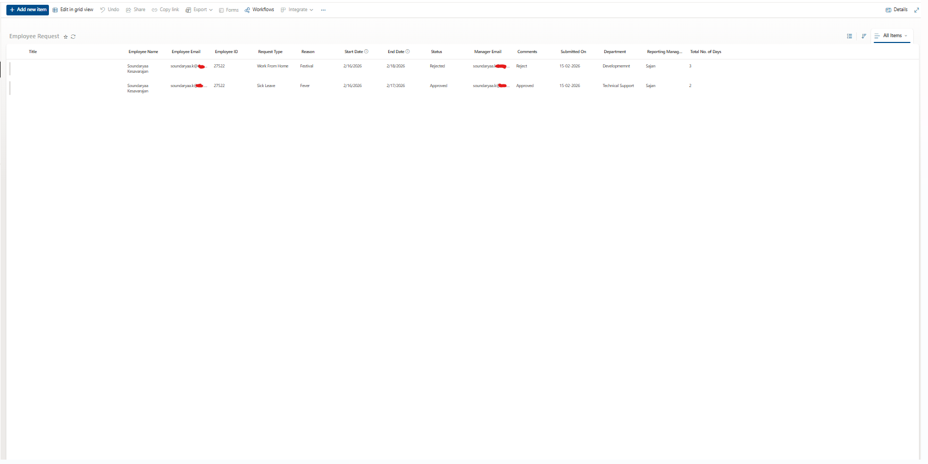
Employee Request SharePoint List

Slide 11
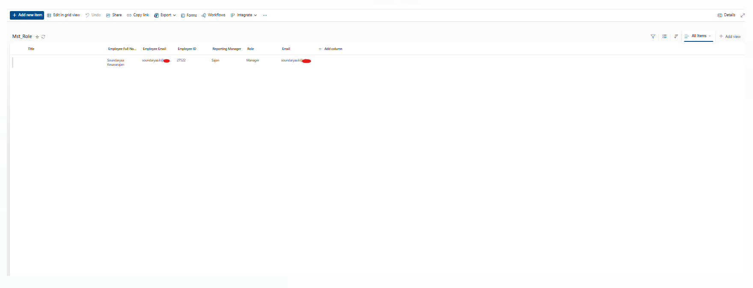
Master Role SharePoint List

Slide 12
Email Workflow

Slide 13
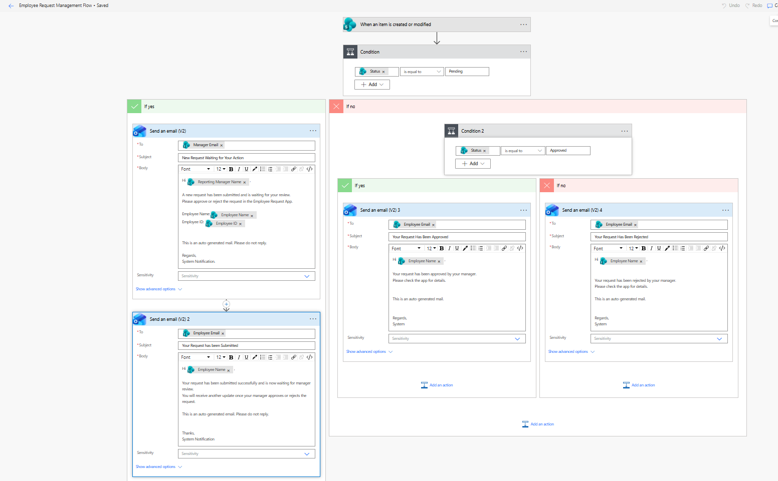
Employee Request Management Workflow

Slide 14

Email Notification

Slide 15
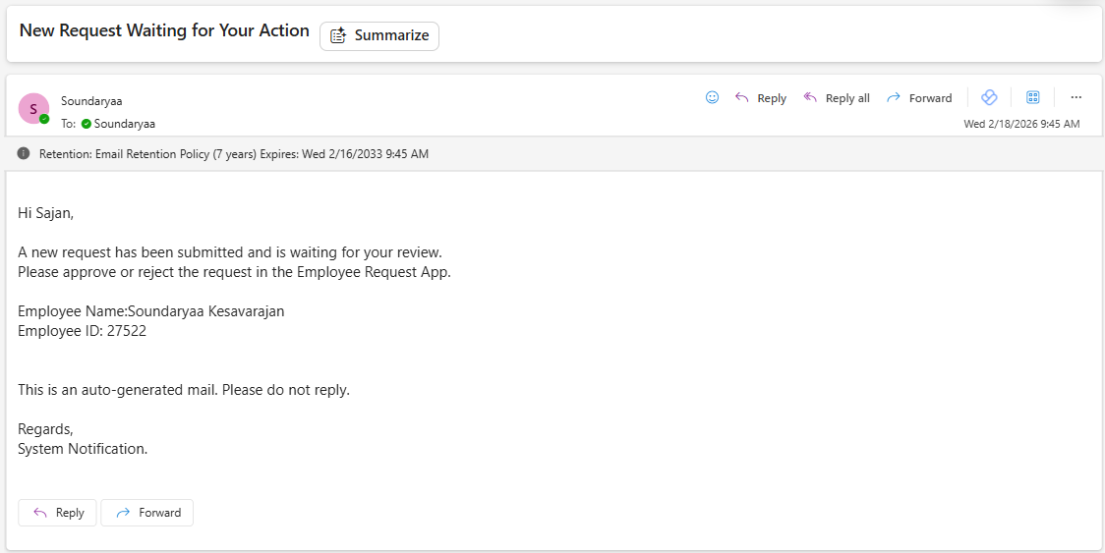
Email Notification to the Manager

Slide 16
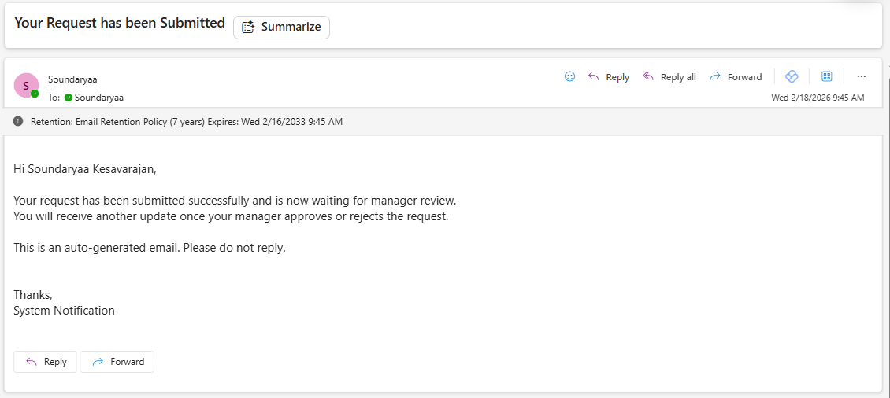
Email Notification to the Employee

Slide 17
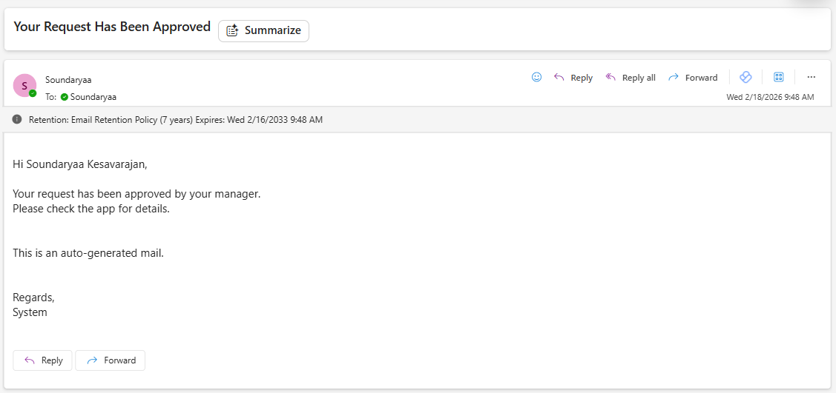
Email Notification to the Employee

Slide 18
Thank You

